Slide 2
BACKGROUND

Slide 3
Query Batching Step 1 : Loop Fission
Query preparation
2 List sumTotals = new ArrayList();
3 PreparedStatement stmt =
conn.prepareStatement(“*query1*”);
8 for (Nation nation : selectedNations) {
stmt.setInt(1, nation.getNationKey());
List sumTotals = new ArrayList();
PreparedStatement stmt =
conn.prepareStatement(“*query1*”);
LoopContextTable lct = new LCT();
int key = nation.getKey();
for (Nation nation : selectedNations) {
LoopContext ctx=
lct.createContext();
stmt.setInt(1, key);
ctx.setInt("nation", key);
stmt.addBatch(ctx);
}
Query 1 :
SELECT sum(o.total_price) as sumTotal
FROM Orders o, Customers c
WHERE o.cust_ref = c.cust_key
AND c.nation_ref = ?
Notes:
At first a fragment is identified as a potential

Slide 4
Query Batching Step 2 : Set Oriented Execution
Java program for example 1 after loop split
List sumTotals = new ArrayList();
PreparedStatement stmt =
conn.prepareStatement(“*query1*”);
LoopContextTable lct = new LCT();
int key = nation.getKey();
for (Nation nation : selectedNations) {
LoopContext ctx=
lct.createContext();
stmt.setInt(1, key);
ctx.setInt("nation", key);
stmt.addBatch(ctx);
}
Parameter Batch
Batch form query execution in database
DB
stmt.executeBatch();
for (LoopContext ctx : lct) {
ResultSet rs =
stmt.getResultSet(ctx);
rs.next();
int sum = rs.getInt("sum");
sumTotals.add(Pair.of(nation, sum));
}
return sumTotals;
Set of result sets

Slide 5
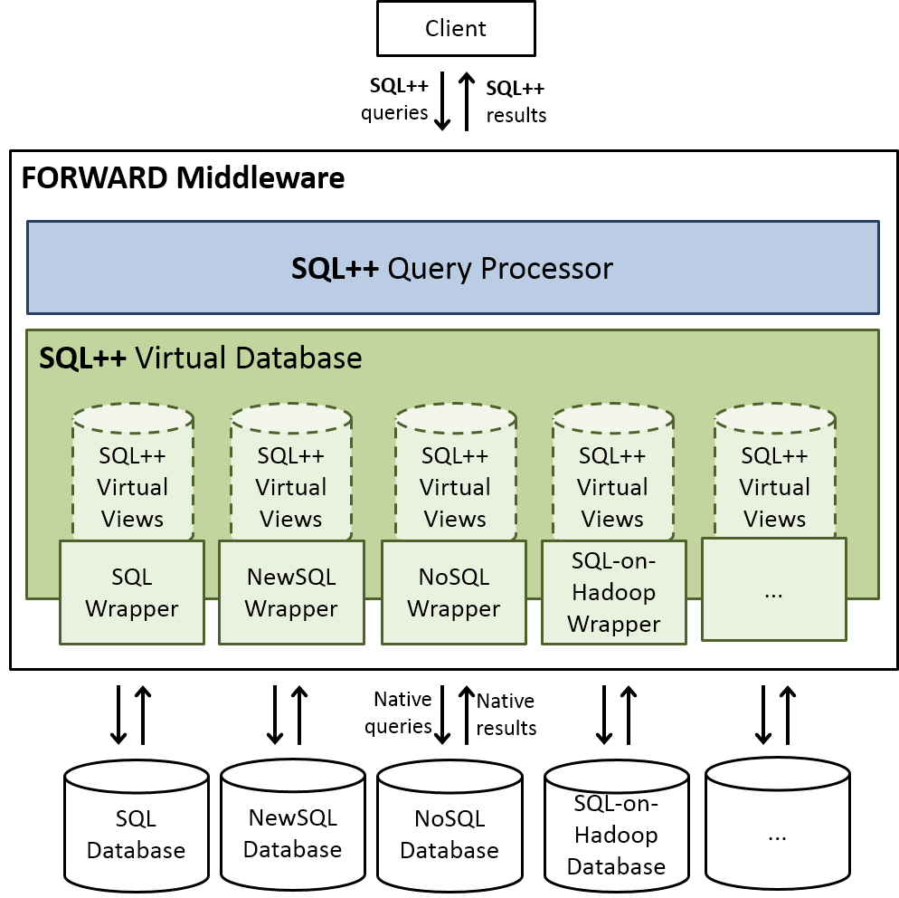

Slide 7
